Slide 1
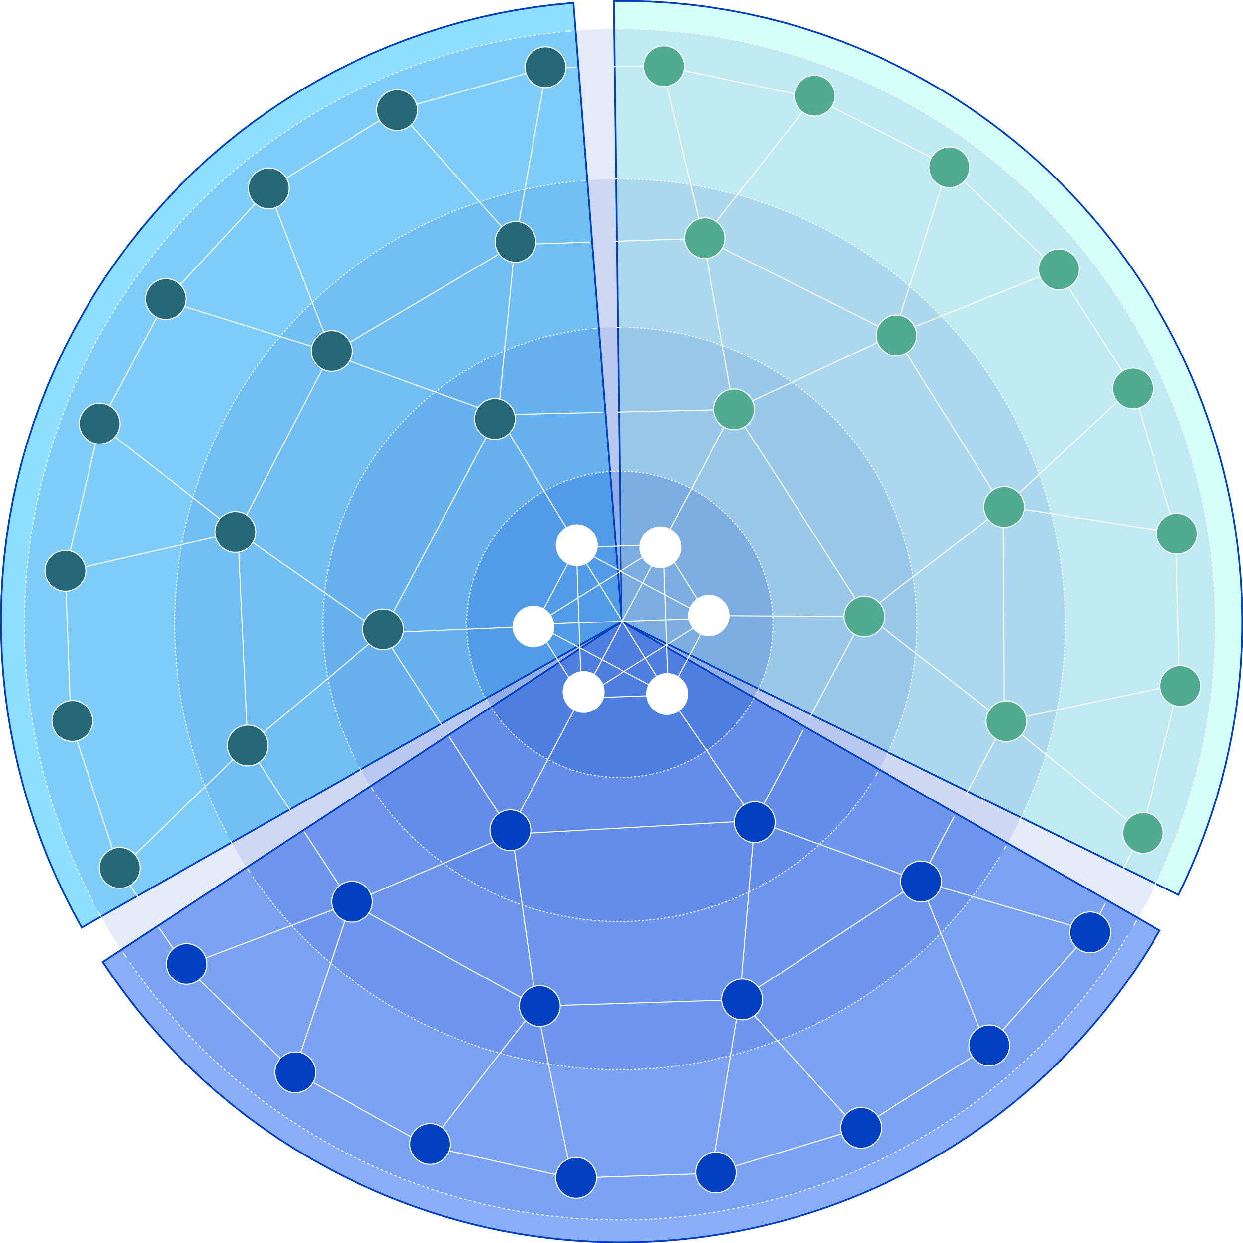
How Teranode Enables Unbounded Scaling

Slide 2
What is Bitcoin?
A peer-to-peer electronic cash system
An edge-to-edge electronic value system

Slide 3
An Edge-to-edge Electronic Value System
Web3 based on blockchain
Web3 Based On Blockchain

Slide 4
One Blockchain, Countless Uses
Streaming services
CBDCs
Data privacy
Web3 Based On Blockchain

Slide 5
Streaming services
Traditional model
Blockchain model
Streaming company
Streaming company
Tie user analytics with financials
Pay for what you want
Subscription
¢
User

Slide 6
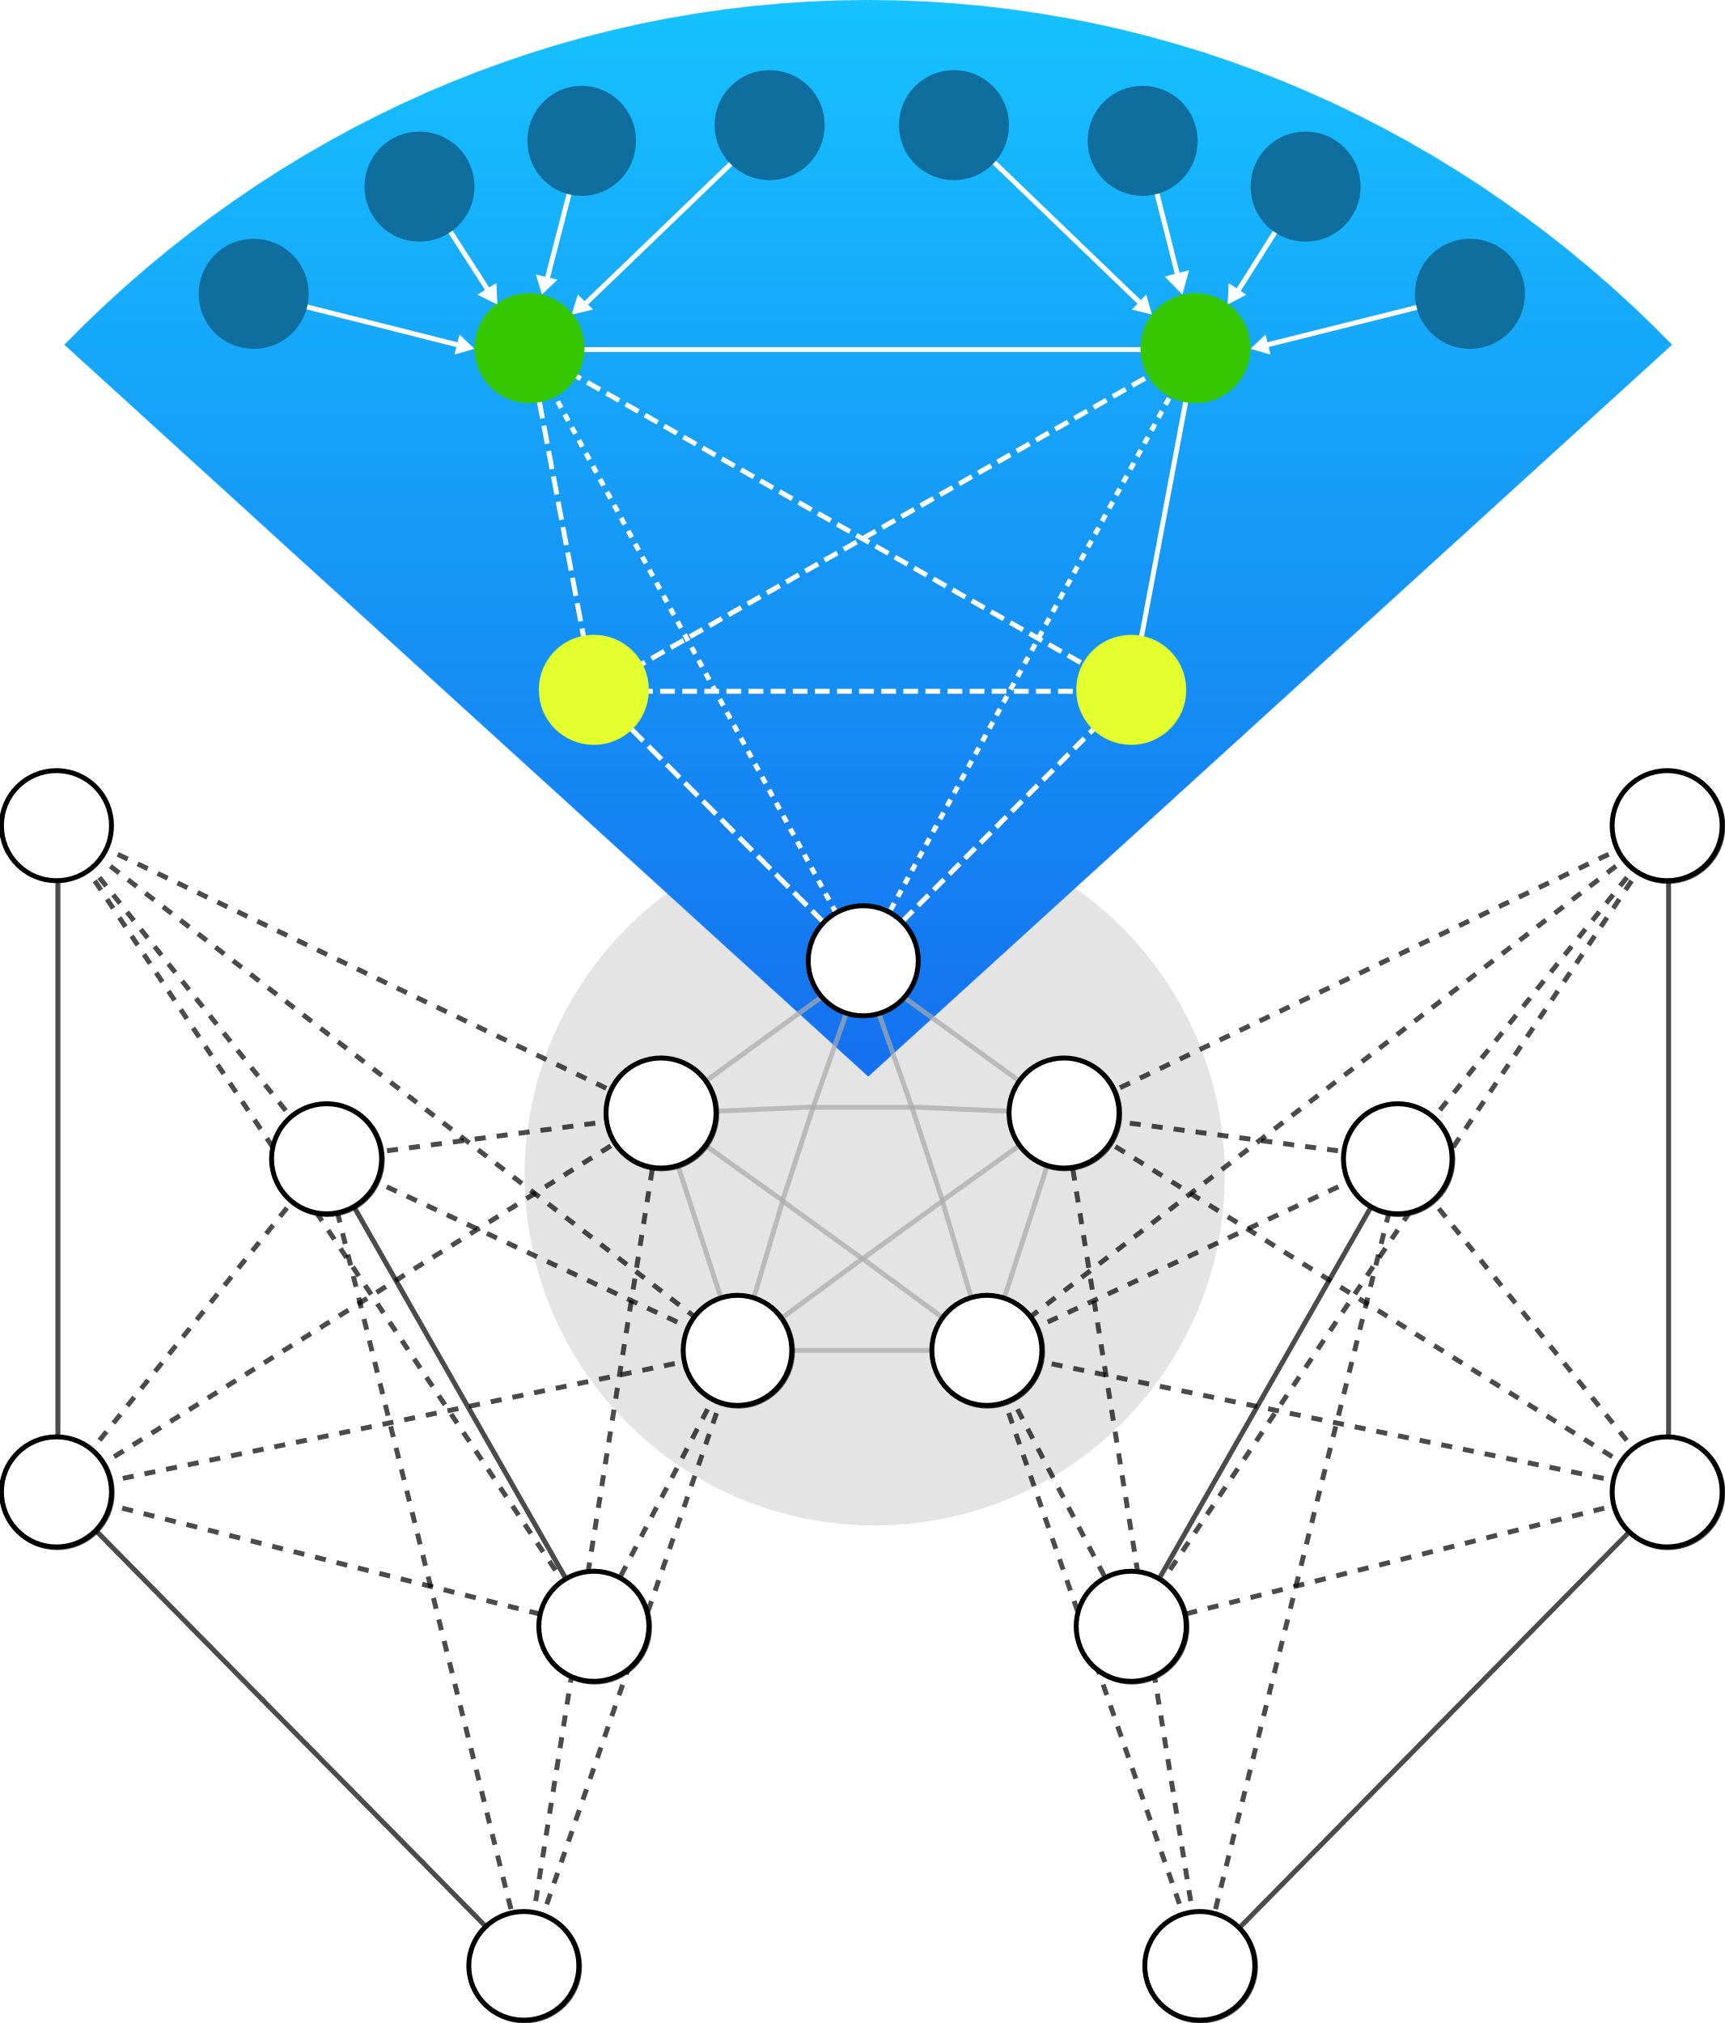
Central bank digital currencies (CBDCs)
Alternatives?
£
Only possible with one blockchain
Traditional client-server model
SPV wallets
Central bank overlay nodes
Specialized nodes
Node network
“Private blockchain”
$
¥

Slide 7
Data privacy
Traditional model
Blockchain model
Social security number
Home address
Number
Bank accounts
Etc.
Company
Company

Slide 8
Sounds great, but that’s a lot of transactions
Credit cards
Bank of England Digital Pound
Teranode Unbounded
Average: 5000 tps
Theoretical peak: 80,000 tps
Minimum: 30,000 tps
Could require 100,000 tps
Minimum: 1,000,000 tps
Could require 5,000,000 tps
tps = transactions per second

Slide 9
Our first attempt​
Teranode
Block assembly
RPC
Transaction validation
Conflicting transactions
Mempool
Block validation
Valid or invalid block decision
BSN
Chain tracker

Slide 10
Our first attempt​
Block assembly
RPC
Transaction validation
Conflicting transactions
Mempool
Mempool
Block validation
Valid or invalid block decision
BSN
Chain tracker

Slide 11
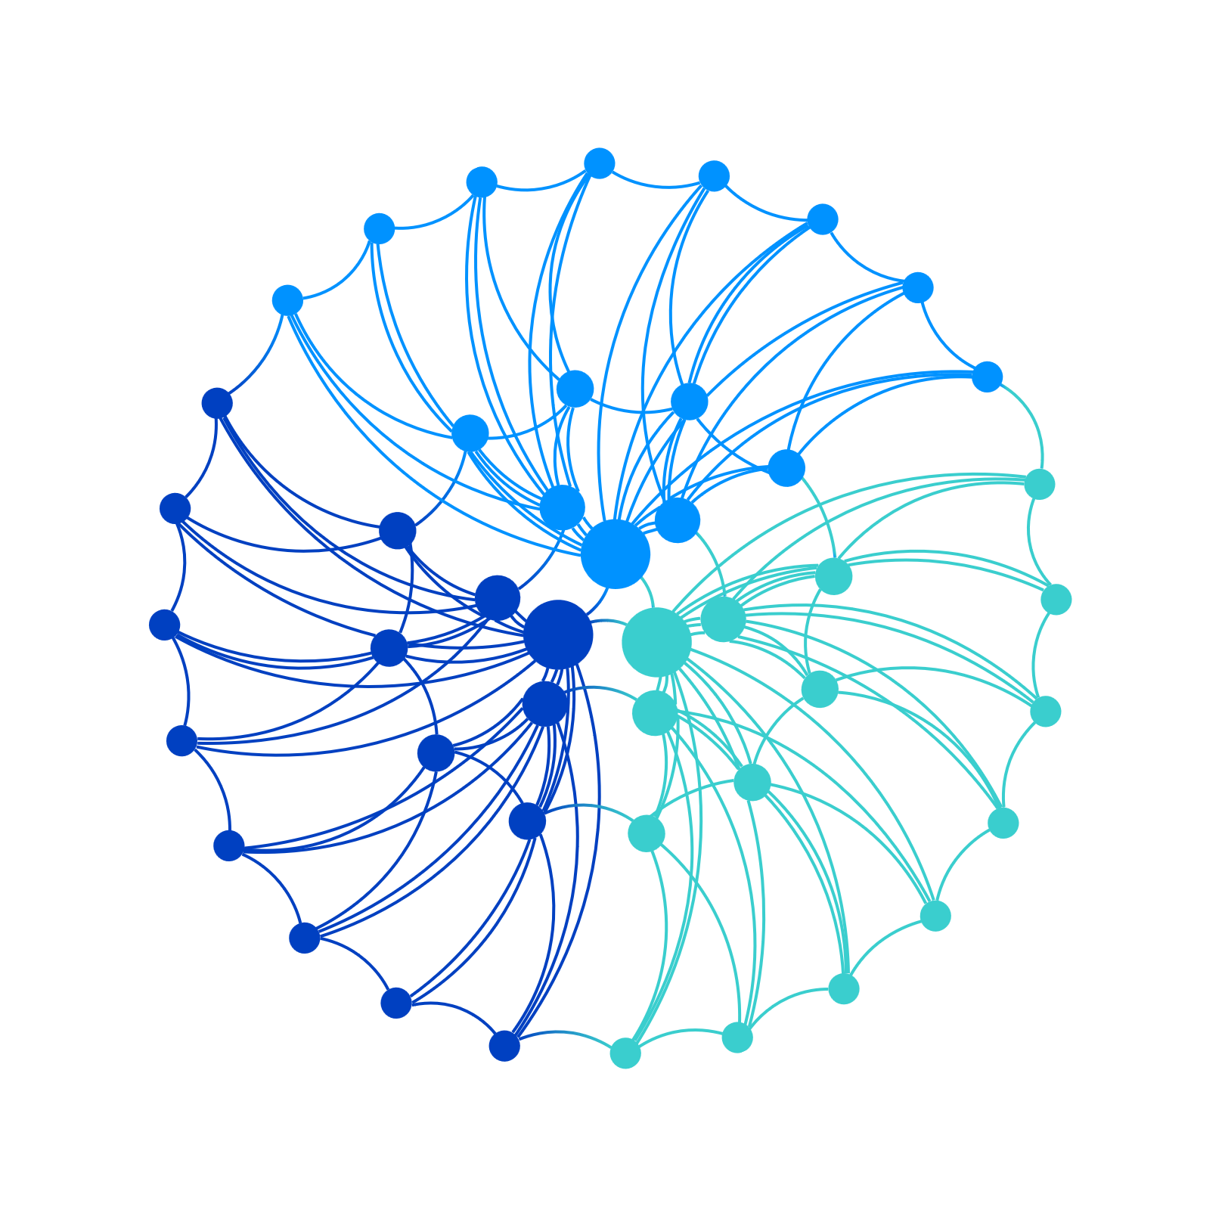
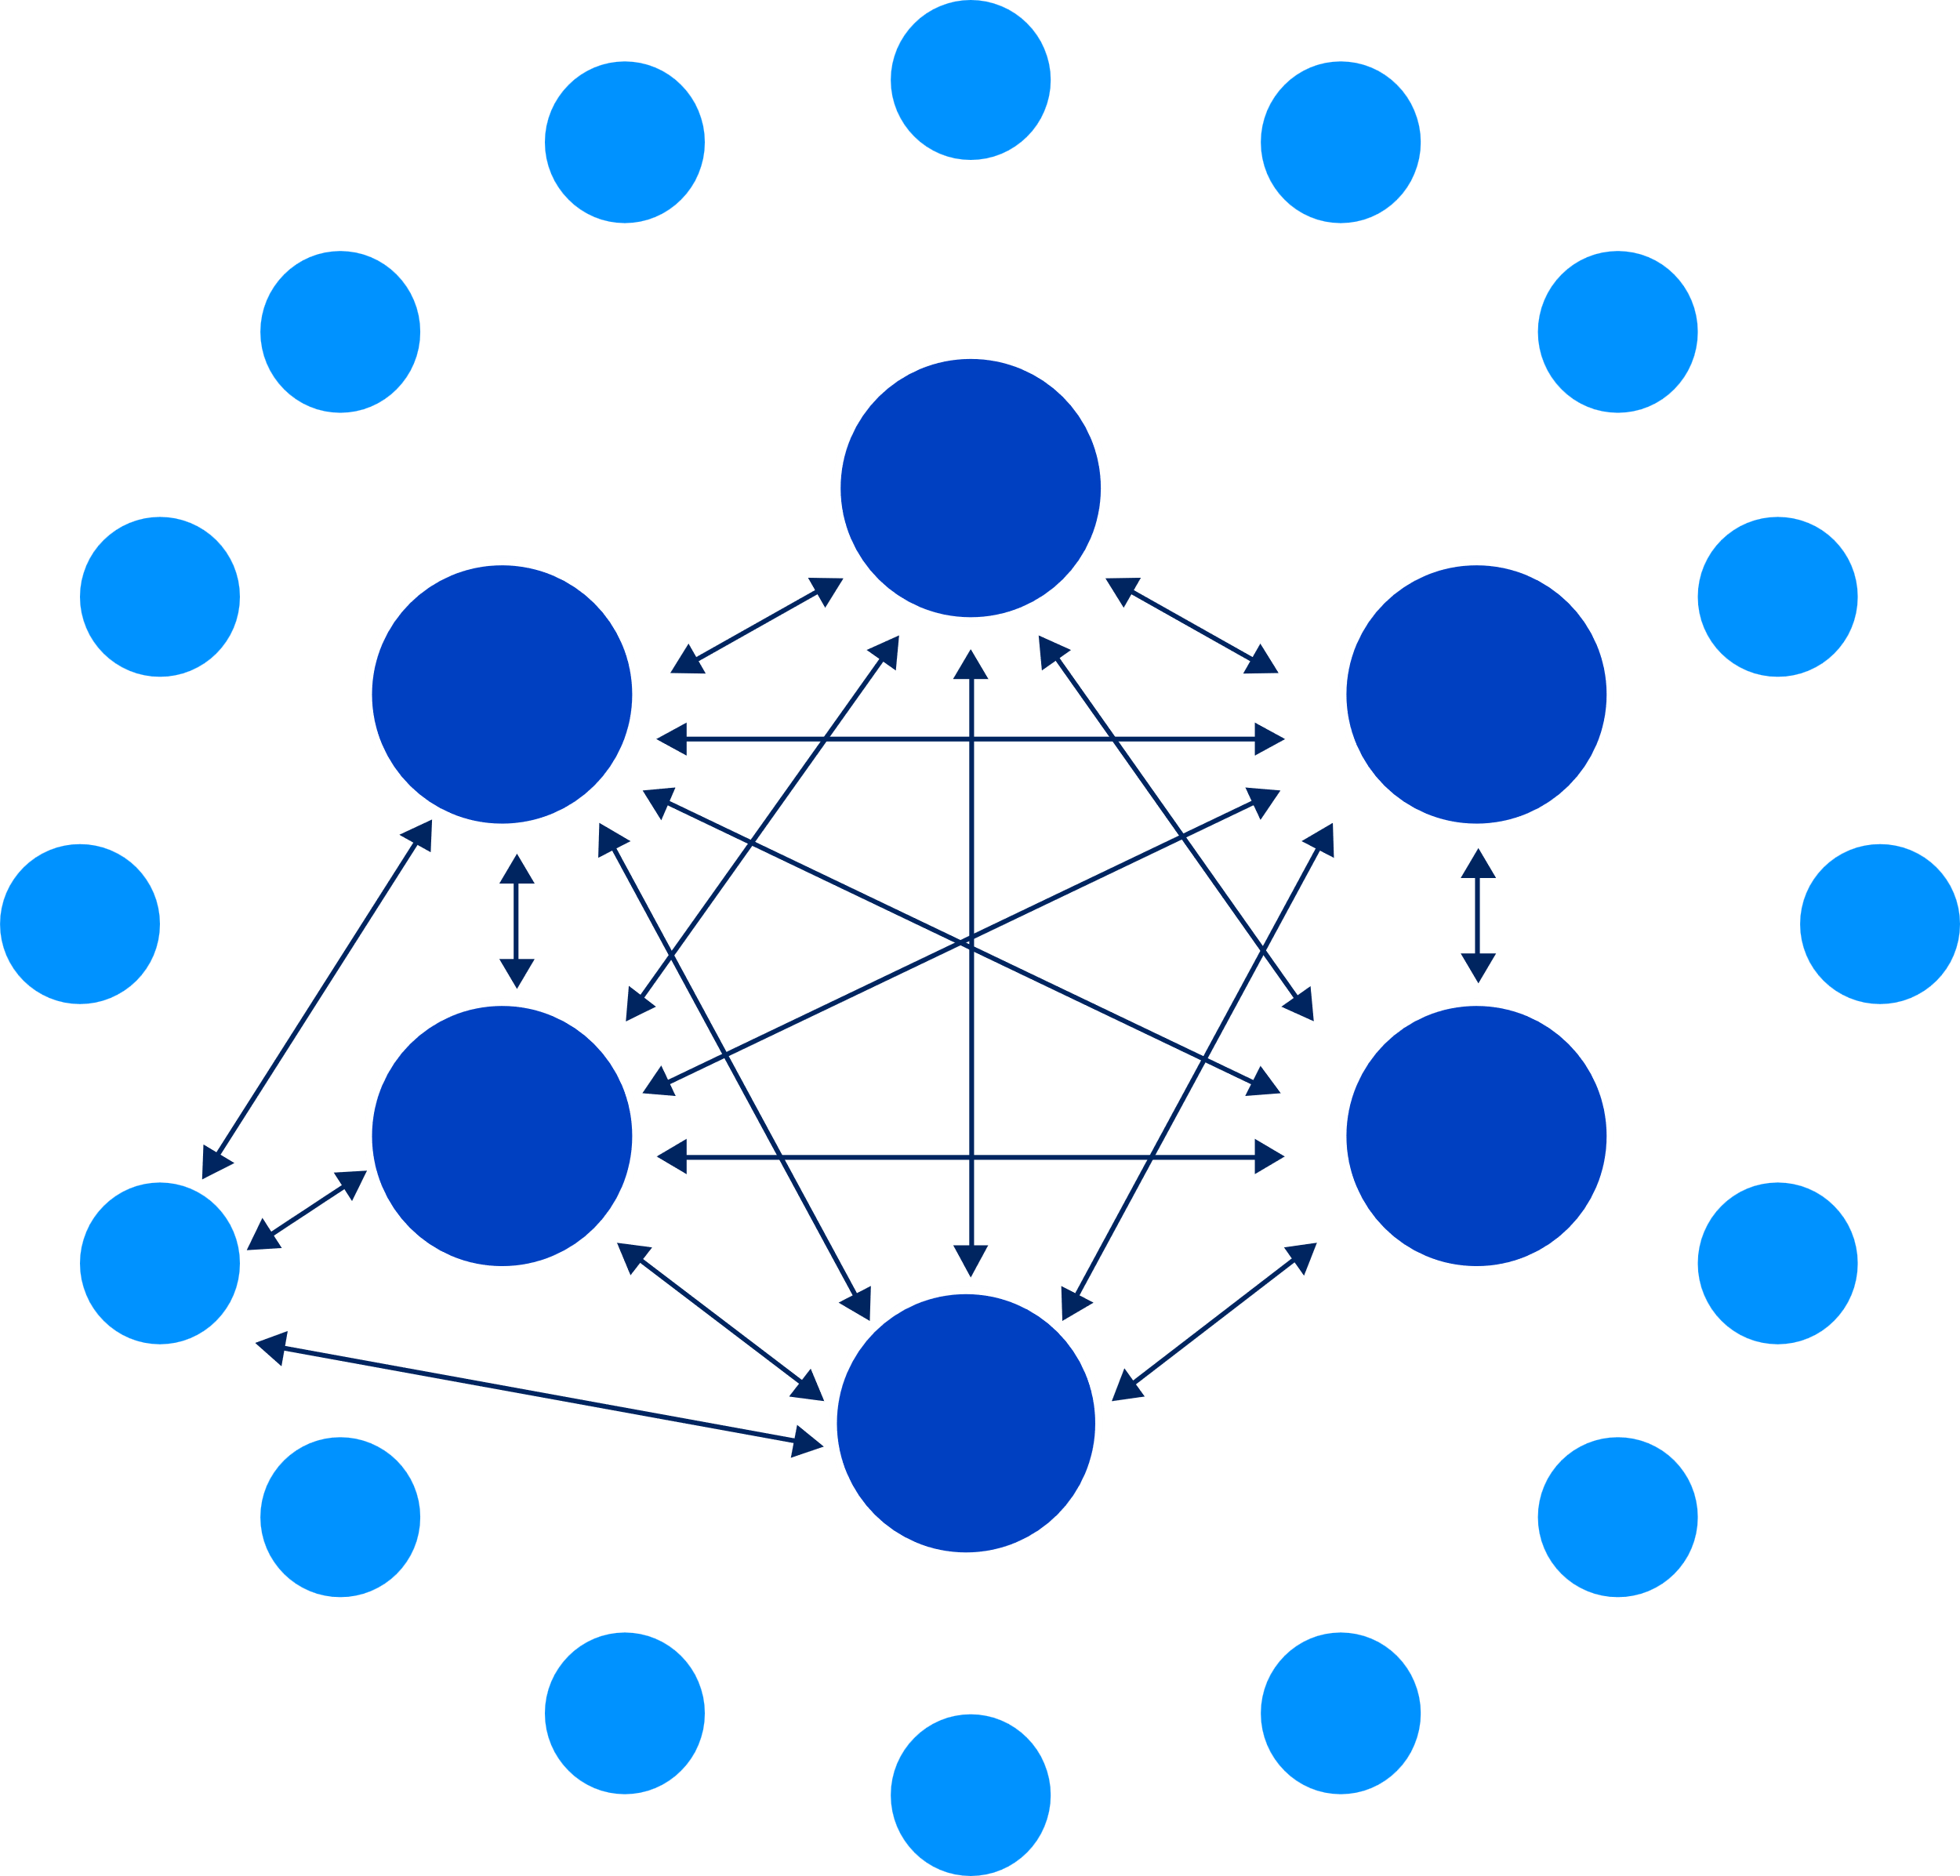
Teranode Evolution​
Current blockchain ​
Development​
Teranode Unbounded
Two layers
Monolithic nodes
Separate functions
Overlay networks

Slide 12
Teranode Unbounded
SPV​ ​
simplified payment ​
verification​
Specialization
of nodes and functions​

Slide 13
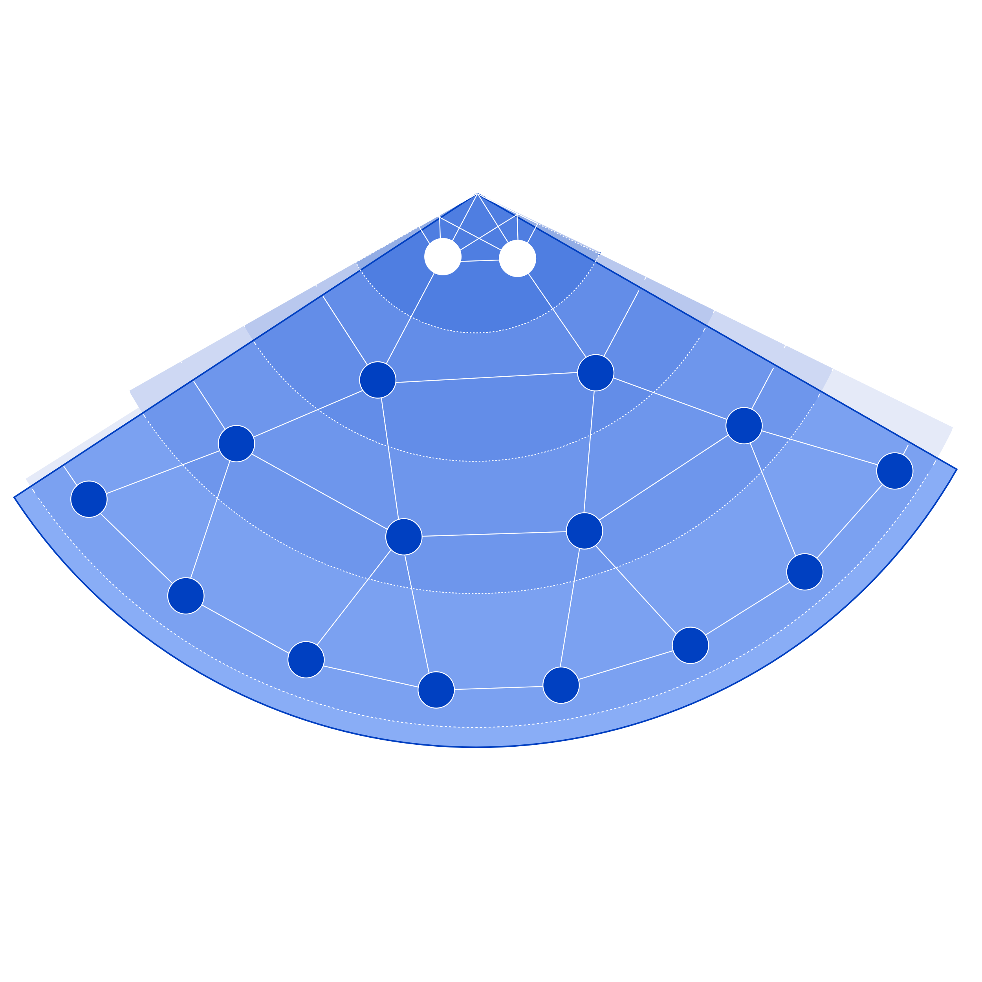
Teranode Unbounded
Node
adds blocks
Specialized node
performs node functions
Overlay node
e.g. bank node
SPV wallet
Specialization
of nodes and functions​
edge-to-edge

Slide 14
Teranode Unbounded
SPV​ ​
simplified payment ​
verification​

Slide 15
Teranode Unbounded
Customer Alice
Merchant Bob

Slide 16
Teranode Unbounded
Alice orders coffee
Bob provides invoice
Customer Alice
Alice hands over payment & Merkle paths
Merchant Bob
Bob calculates Merkle proof(s)
Bob gives Alice her coffee

Slide 17
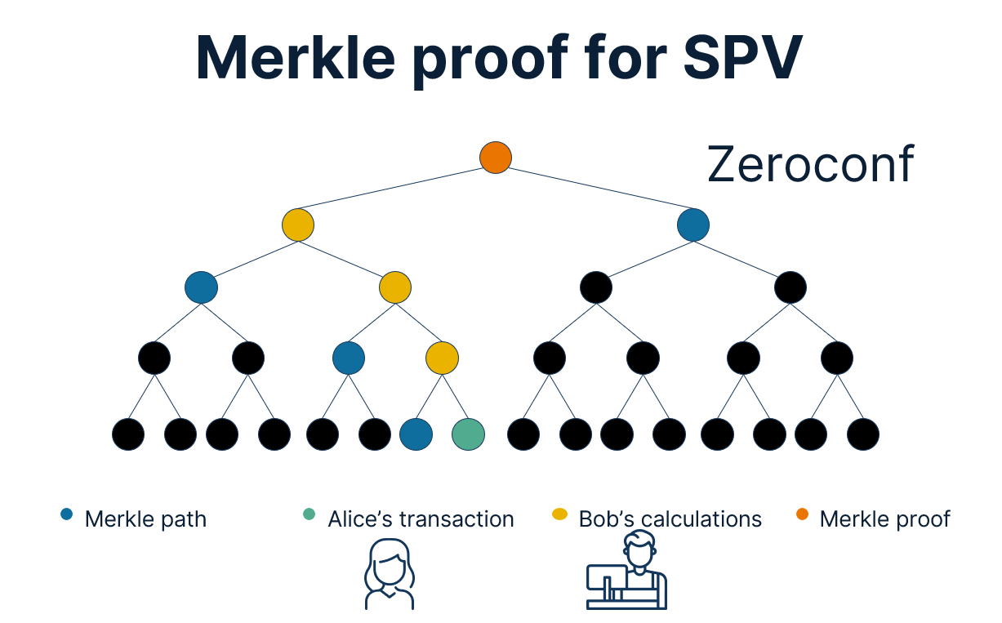
Teranode Unbounded
Overlay node
Submit transaction
Alice orders coffee
Bob provides invoice
Customer Alice
Alice hands over payment & Merkle paths
Merchant Bob
Bob calculates Merkle proof(s)
Bob gives Alice her coffee

Slide 18
Merkle proof for SPV
Zeroconf
Merkle path
Alice’s transaction
Bob’s calculations
Merkle proof

Slide 19
Truly unbounded
SPV​ ​
simplified payment ​
verification​
Specialization
of nodes and functions​

Slide 20
Truly unbounded
Services
Services
Services
Services
Services
Services
Services
Services
BSV node network
Services
Services
Services
Services
Producers
Consumers

Slide 21
One more thing…
developers.bsvblockchain.org/teranode

